Slide 1


Event Sourcing: Microservices Architectural Design Patterns
by SANJAYKUMAR
Notes:
1

Slide 2
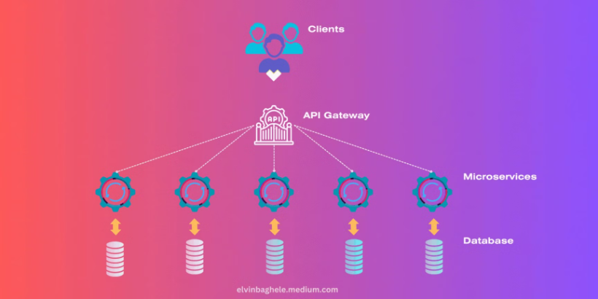
Design patterns
what is design patterns ?
1. Design patterns are proven solutions to common problems in software design, offering reusable templates for structuring code in an efficient and maintainable way.
2. Design patterns are like reusable templates that solve common design problems, improving code flexibility and maintainability.
Notes:
2

Slide 3
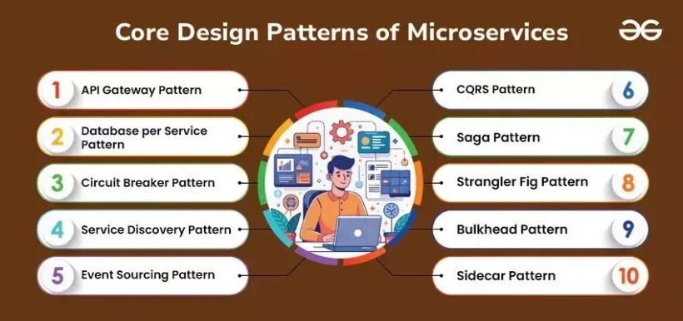
Design Patterns Diagram :
Interesting fact :
An interesting fact about event-driven design patterns is that they decouple event producers from consumers, enabling highly scalable and reactive systems. This approach allows real-time processing, making it ideal for applications like e-commerce order systems or live notifications.
Notes:
3

Slide 4
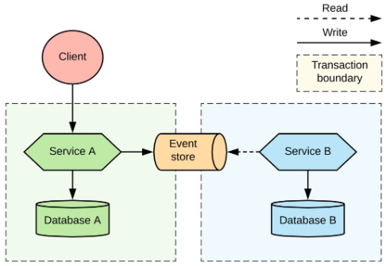
What is Event Sourcing?
A Data Paradigm
Event Sourcing is a way of saving data by keeping a list of all the changes (events) that happen instead of just storing the final result. Each event is permanent, allowing you to track everything that happened in the system
Notes:
4

Slide 5

Real-Time Example Application of Event Sourcing: 1. E-commerce Order Management System 2. Banking Transaction System 3. Subscription Billing System 4. Healthcare Patient Record System 5. Inventory Management System
Notes:
6

Slide 6
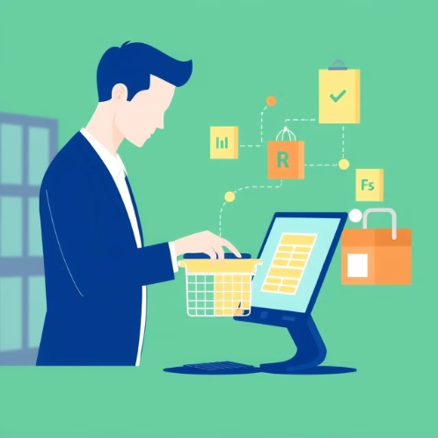
Real-Time Example: E-Commerce Order Processing
Imagine an online shopping platform with the following microservices: Order Service:
Order Service: Handles orders placed by customers.
Inventory Service: Manages product stock levels.
Payment Service: Processes payments.
Notification Service: Sends order confirmation emails
Notes:
5

Slide 7



Key Components of Event Sourcing
Events
Event Store
Aggregates
Events represent changes in the order processing system. Examples include "Order Created", "Payment Processed", and "Inventory Updated". Each event is immutable and captures a specific action in the order lifecycle.
The event store is a specialized database that stores events like "Order Created", "Payment Successful", and "Inventory Adjusted". It ensures that all events are safely stored and can be retrieved efficiently to reconstruct the order's history.
Aggregates represent key business entities, like an Order. An Order Aggregate might encapsulate a sequence of events such as "Order Created", "Payment Processed", and "Inventory Updated". These events modify the state of the order, providing a consistent view of its current status..
Notes:
7

Slide 8
Implementing Event Sourcing in Microservices
Define Events
1
Identify key events in the order processing system, such as OrderPlaced, PaymentProcessed, InventoryReserved, and OrderShipped. Each event represents a significant change in the order lifecycle.
Choose an Event Store
2
Use a reliable event store like Kafka or EventStoreDB to persist events, ensuring durability and high scalability for handling large volumes of data.
Design Aggregates
3
Group related events under aggregates like OrderAggregate for managing orders and InventoryAggregate for stock, encapsulating state and business logic.
Build Event Handlers
4
Event handlers process events; for instance, OrderPlaced triggers InventoryService to reserve stock and NotificationService to send a confirmation email.
Notes:
8

Slide 9
Challenges and Considerations
Performance Overhead
Complexity
Event Schema Evolution
Event replay for rebuilding order or inventory state can slow down operations. Efficient snapshotting and indexing are needed to optimize performance.
Designing event-driven order management requires careful planning, which increases system complexity and demands a deeper understanding of event sourcing principles.
Adapting to changes in event structures, like adding fields to OrderPlaced, needs versioning strategies to maintain backward compatibility without system failures.
Notes:
9

Slide 10

Notes:
10

